Slide 1

Medical Store-Distributor-Consumer Network
Abdulla Iqbal FA17-BSE-030
Armaghan Hassan FA17-BSE-045
Majid Durani FA17-BSE-021
Supervisor: Sir Kashif Nasir
Department of Computer Science
COMSATS University Islamabad, Abbottabad

Slide 2
Agenda
Agenda of the presentation is to see the complete project in working state.
MSDCN Website
MSDCN Android App

Slide 3
Project Introduction
The Medical Store Distributor Consumer Network (MSDCN) is a website which allows the Retailer and Distributer to maintain their inventory and to sell their stock, this will be used by Medical store and Pharmaceutical Distributors. This website will store details of medicine purchase and selling w.r.t Retailer and Distributor. The website will also consist of Billing generation, Reporting module, Transection and Medicine shortage notification module.

Slide 4
Project Scope
“Our system will target Medicine market. The problem with current medicine market is that all the communication, transactions and order placing is based on paperwork and wire transfers which results in delays and there is no monitoring. Our system will provide online platform for both Medical Stores and Pharmaceutical Distributors. It will allow them to monitor their transaction, online payment, online store, order details, point of sale details, inventory managements and will generate reports based on profit and loss.”
“Our system will only cover the online purchasing module up to the payment.”

Slide 5
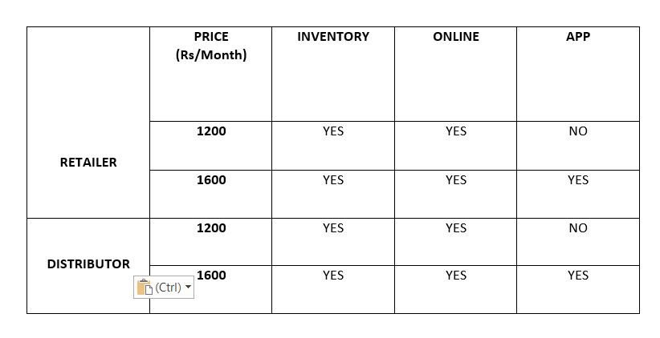
Our Packages

Slide 6
Functional Requirements
FR-1: A new Retailer and Distributor would be able to get register
FR-2: Retailer and Distributor cannot login until Admin verifies them(Payment, License).
FR-3: Retailer and Distributor shall be able to select the desired package.
FR-4: Retailer and Distributor can register multiple times but Email, License No must be different.
FR-5: Retailer and Distributor can login by using Email and Password provided while registration.
FR-6: Retailer should be able to buy Medicines online from the Distributor and he can also pay for that order through online means or Cash on Delivery.
FR-7: Retailer shall be able to use the Point of Sale to sell their stock to the Customer.
FR-8: Retailer and Distributor shall be notified if the product is about to get out of stock.
FR-9: Retailer and Distributor shall be able to maintain their inventory by adding, deleting and updating the items.

Slide 7
Functional Requirements
FR-10: Retailer shall manually update the stock in their inventory.
FR-11: When Distributer add the product in the inventory it shall automatically be available to the Retailer at the Online Store.
FR-12: Retailer and Distributor should be able to generate reports based on Daily, Monthly and Yearly.
FR-13: Retailer and Distributor should be able to see their transection detail
FR-14: Retailer and Distributor Should be able to only change the Email, Password, Contact and Online Payment details
FR-15: Medicine Retailer price and Distributor price should be set by themselves.

Slide 8
Non-Functional Requirements
NFR-1: Retailer and Distributor should be able to learn how to operate the website with in 30 min of training.
NFR-2: Down time of the website should not exceed more than 10 sec for continuous succession of 500 hrs.
NFR-3: Website should be able to handle 100 hits per minute.
NFR-4: Website should be able to work on any browser.
NFR-5: The system development process and deliverable documents shall conform to the ISO STANDARDS
NFR-6: The system shall not disclose any personal information about members of the MSDCN to other members except system administrators.
NFR-7: Credit Card details should be stored in an encrypted form.
NFR-8: Our company is complied with the local and national laws regarding the use of software tools and User privacy.

Slide 9
Activity Diagram

Slide 10
Class Diagram

Slide 11
E-R Diagram

Slide 12
Use Cases Diagram

Slide 13
System Block Diagram

Slide 14
Test Cases
No. | Objective | Input Data | Expected Result | Result
3 | Retailer and Distributor enters the required credentials correctly and press “Register” button. | Email: armaghan@test.com Password: password CNIC: 1310160871515 Contact: 03409314148 CNIC-Front-Pic: .jpge/.png CNIC-Back-Pic: .jpge/.png Shop Name: Armag Shop License No: 123654789 License-F-Pic: .jpge/.png License-B-Pic: .jpge/.png Payment Method: Barcode Pic: .jpge/.png | Successfully shows the subscription package page. | Pass
 | Retailer and Distributor enters any of the required credentials incorrectly and press “Register” button. | Email: armaghan@test Password: password CNIC: 131015 Contact: 0340 CNIC-Front-Pic: N/A CNIC-Back-Pic: .jpge/.png Shop Name: Armag Shop License No: 123654789 License-F-Pic: .jpge/.png License-B-Pic: .jpge/.png Payment Method: N/A Barcode Pic: .jpge/.png | “Enter the proper credentials after reading the help box.” | Pass

Slide 15
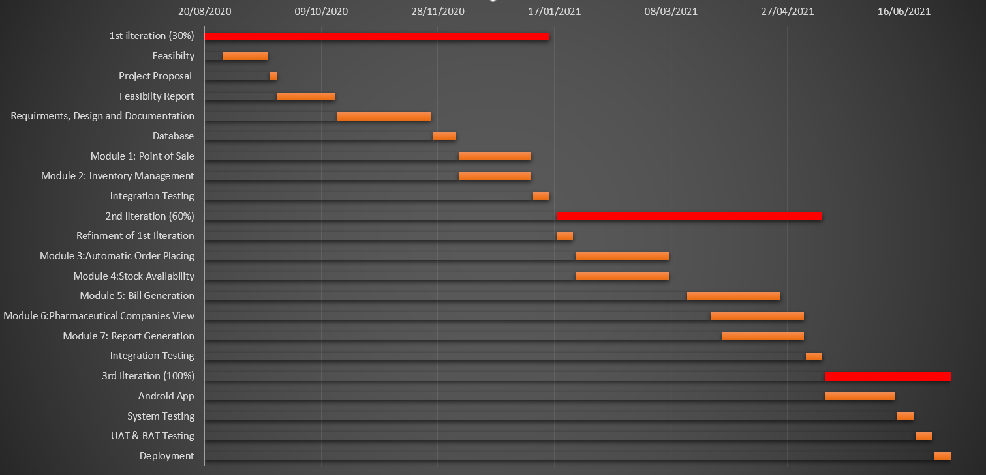
Gantt Chart

Slide 16
Status of Thesis Report
Enlist your progress, chapters completed and topics covered

